Slide 1
Op-Amps and Comparators
Unit 22

Slide 2
2018/19 S1
Modified Examination Questions

Slide 3

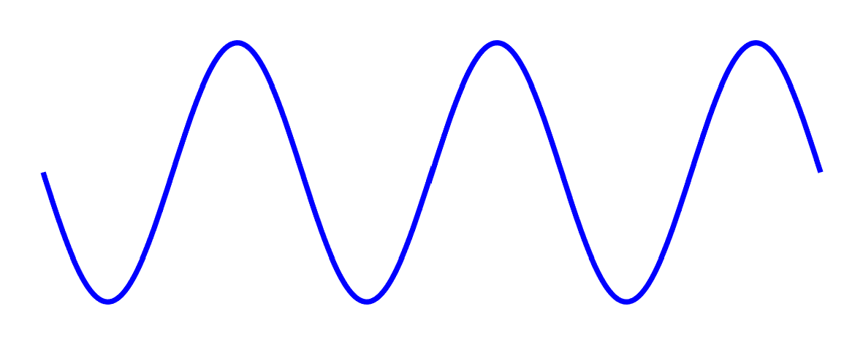
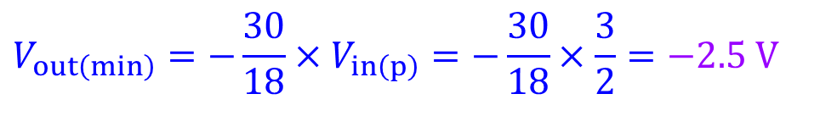


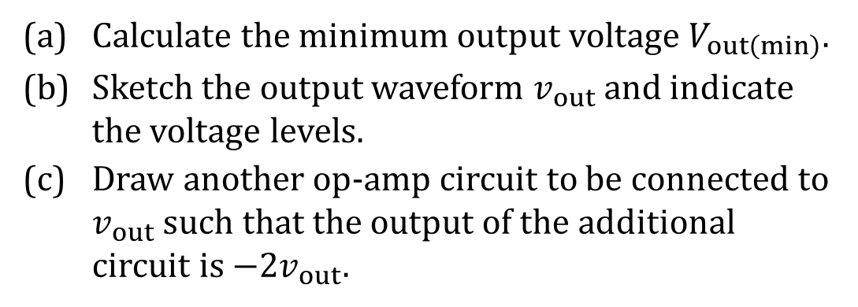







18/19 S1 B3 (modified)
Explanation
Calculate the minimum output voltage $V_{out\left(min\right)}.$
Sketch the output waveform $v_{out}$ and indicate the voltage levels.
(c) Draw another op-amp circuit to be connected to $v_{out}$ such that the output of the additional circuit is $−2v_{out}.$
30 k Ω
18 k Ω
$$+V_{S}$$
−
$$v_{out}$$
$${3 V}_{p‑p}$$
+
$$−V_{S}$$
Solution
$$V_{out\left(min\right)}=−\frac{30}{18}×V_{in\left(p\right)}=−\frac{30}{18}×\frac{3}{2}=−2.5 V$$
(a)
Solution
(c)
2R
(b)
$$v_{out} (V)$$
$$v_{out}$$
R
$$+V_{S}$$
2.5
−
$${−2v}_{out}$$
0
+
t
$$−V_{S}$$
−2.5

Slide 4
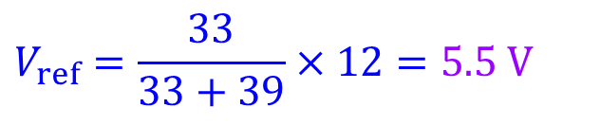


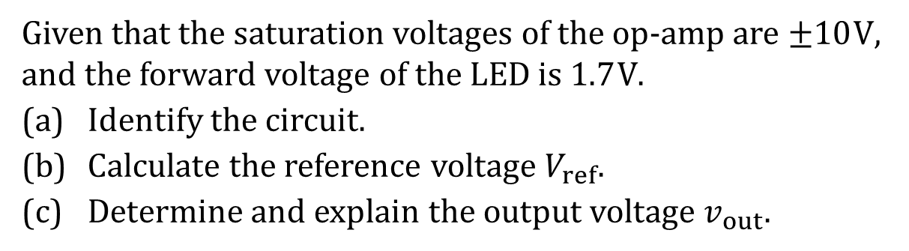






18/19 S1 B4 (modified)
Explanation
Given that the saturation voltages of the op-amp are $±10 V$, and the forward voltage of the LED is $1.7 V$.
Identify the circuit$.$
Calculate the reference voltage $V_{ref}$.
Determine and explain the output voltage $v_{out}.$
$$+12 V$$
39 k Ω
$$V_{ref}$$
−
$$v_{out}$$
Solution
+
(a)
Comparator circuit.
6 V
33 k Ω
$$−12 V$$
$$R_{L}$$
$$V_{ref}=\frac{33}{33+39}×12=5.5 V$$
(b)
(c)
$V_{+}=6 V$ and $V_{−}=V_{ref}=5.5 V$
$${∵V}_{+} >V_{−}$$
$${∴v}_{out} ={+V}_{sat} =10 V$$

Slide 5
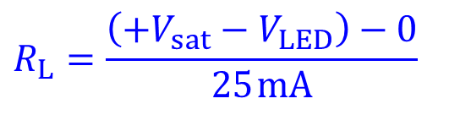

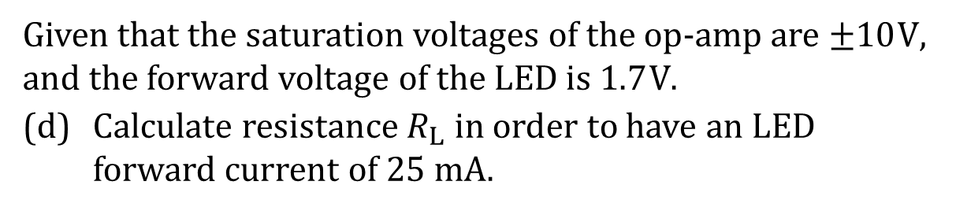

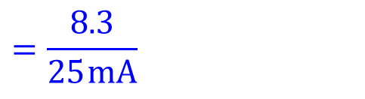
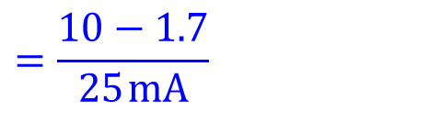
18/19 S1 B4 (modified)
Given that the saturation voltages of the op-amp are $±10 V$, and the forward voltage of the LED is $1.7 V$.
(d) Calculate resistance $R_{L}$ in order to have an LED forward current of 25 mA.
$$+12 V$$
39 k Ω
$$V_{ref}$$
−
$$v_{out}$$
Solution
$$R_{L}=\frac{\left(+V_{sat}−V_{LED}\right)−0}{25 mA}$$
+
(d)
6 V
33 k Ω
$$−12 V$$
$$R_{L}$$
$$=\frac{10−1.7}{25 mA}$$
$$=\frac{8.3}{25 mA}$$
$$=0.332 kΩ$$
$$=332 Ω$$

Slide 6
2017/18 S2
Modified Examination Questions

Slide 7




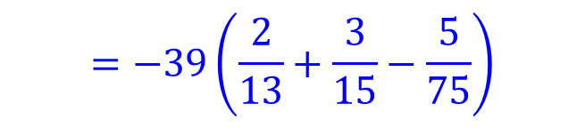
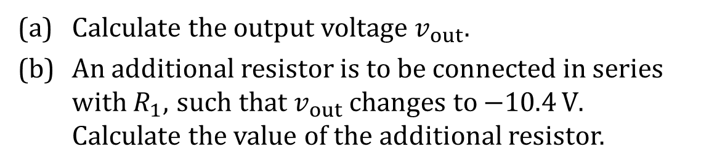

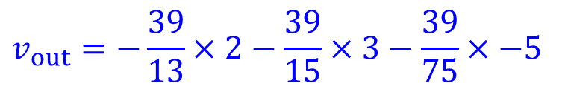




17/18 S2 B3 (modified)
Explanation
(a) Calculate the output voltage $v_{out}.$
(b) An additional resistor is to be connected in series with $R_{1}$, such that $v_{out}$ changes to $−10.4 V$. Calculate the value of the additional resistor.
$R_{1}$ 13 k Ω
$R_{4} 39$ k Ω
$$2 V$$
$R_{2}$ 15 k Ω
$$3 V$$
−
$$v_{out}$$
Solution
$R_{3} 75$ k Ω
+
$$−5 V$$
$$v_{out}=−\frac{39}{13}×2−\frac{39}{15}×3−\frac{39}{75}×−5$$
(a)
$$=−39\left(\frac{2}{13}+\frac{3}{15}−\frac{5}{75}\right)$$
$$=−11.2 V$$

Slide 8
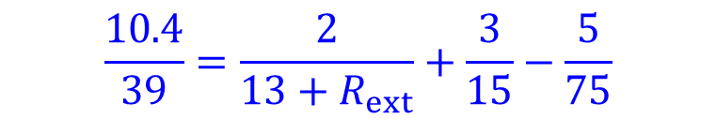
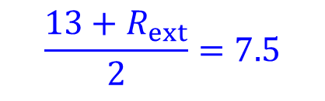
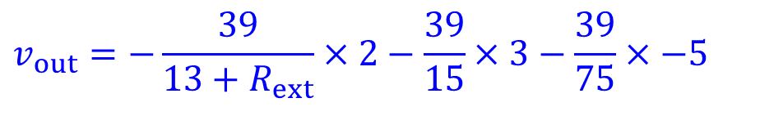
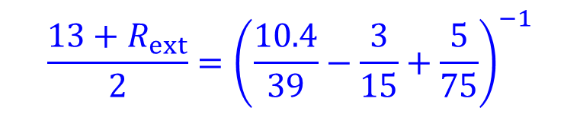

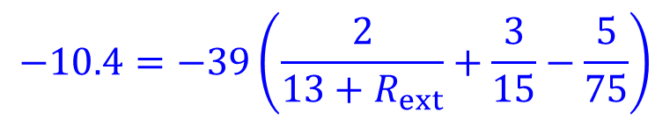

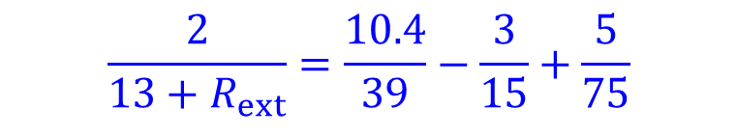
17/18 S2 B3 (modified)
(a) Calculate the output voltage $v_{out}.$
(b) An additional resistor is to be connected in series with $R_{1}$, such that $v_{out}$ changes to $−10.4 V$. Calculate the value of the additional resistor.
$R_{1}$ 13 k Ω
$R_{4} 39$ k Ω
$$2 V$$
$R_{2}$ 15 k Ω
$$3 V$$
−
$$v_{out}$$
Solution
$R_{3} 75$ k Ω
+
$$−5 V$$
$$v_{out}=−\frac{39}{13+R_{ext}}×2−\frac{39}{15}×3−\frac{39}{75}×−5$$
(b)
$$−10.4=−39\left(\frac{2}{13+R_{ext}}+\frac{3}{15}−\frac{5}{75}\right)$$
$$\frac{13+R_{ext}}{2}={\left(\frac{10.4}{39}−\frac{3}{15}+\frac{5}{75}\right)}^{−1}$$
$$\frac{10.4}{39}=\frac{2}{13+R_{ext}}+\frac{3}{15}−\frac{5}{75}$$
$$\frac{13+R_{ext}}{2}=7.5$$
$$\frac{2}{13+R_{ext}}=\frac{10.4}{39}−\frac{3}{15}+\frac{5}{75}$$
$$R_{ext}=7.5×2−13$$
$$=2 Ω$$

Slide 9









17/18 S2 B3 (modified)
(c) Draw another op-amp circuit to be connected to the output $v_{out}$ of the given summing amplifier such that the output of the additional circuit is equal to $−4v_{out}.$
Solution
$R_{1}$ 13 k Ω
$R_{4} 39$ k Ω
$$2 V$$
(c)
4R
$R_{2}$ 15 k Ω
$$3 V$$
−
$$v_{out}$$
$$v_{out}$$
R
$$+V_{S}$$
−
$${−4v}_{out}$$
$R_{3} 75$ k Ω
+
$$−5 V$$
+
$$−V_{S}$$

Slide 10
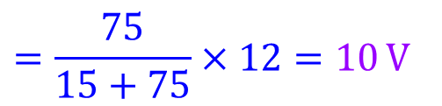
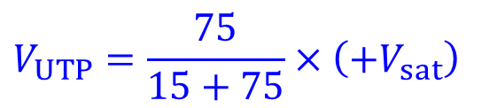

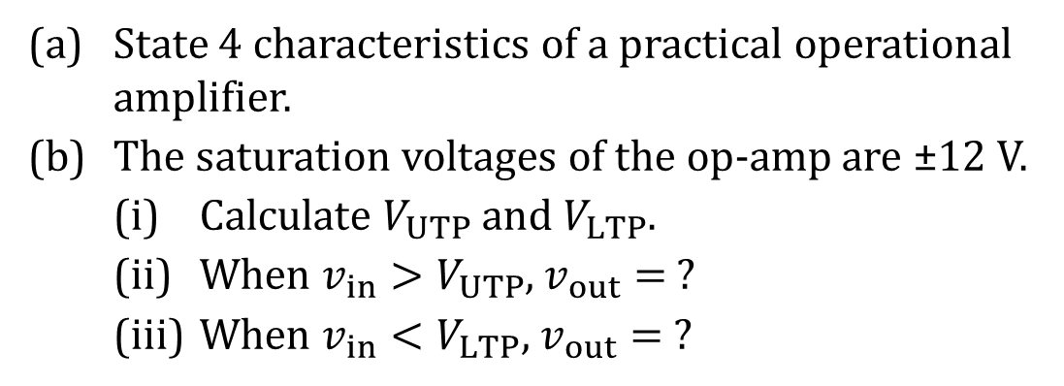


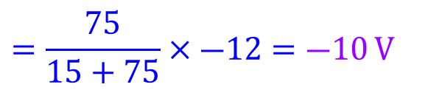


17/18 S2 B4 (modified)
Explanation
(a) State 4 characteristics of a practical operational amplifier.
(b) The saturation voltages of the op-amp are ±12 V.
(i) Calculate $V_{UTP}$ and $V_{LTP}$.
(ii) When $v_{in}>V_{UTP}$, $v_{out}= ?$
(iii) When $v_{in}<V_{LTP}$, $v_{out}= ?$
$$+V_{S}$$
−
$$v_{out}$$
$${ v}_{in}$$
+
$$−V_{S}$$
15 k Ω
75 k Ω
Solution
$$V_{UTP}=\frac{75}{15+75}×\left(+V_{sat}\right)$$
(b) (i)
(a) Very high open-loop voltage gain, very high input impedance
very low output impedance, and
finite bandwidth.
$$=\frac{75}{15+75}×12=10 V$$
$$V_{LTP}=\frac{75}{15+75}×\left(―V_{sat}\right)$$
$$=\frac{75}{15+75}×―12=―10 V$$

Slide 11








17/18 S2 B4 (modified)
(a) State 4 characteristics of a practical operational amplifier.
(b) The saturation voltages of the op-amp are ±12 V.
(i) Calculate $V_{UTP}$ and $V_{LTP}$.
(ii) When $v_{in}>V_{UTP}$, $v_{out}= ?$
(iii) When $v_{in}<V_{LTP}$, $v_{out}= ?$
$$+V_{S}$$
−
$$v_{out}$$
$${ v}_{in}$$
+
$$−V_{S}$$
15 k Ω
75 k Ω
Solution
(b) (ii)
$∵v_{in}$ is applied to the inverting terminal.
${∵V}_{+}$ is either equal to $V_{UTP}$ or $V_{LTP}$.
$${∴v}_{in}=V_{−}$$
$${∴V}_{−} >V_{+}$$
∴ When $v_{in}>V_{UTP}$, $V_{−}>V_{UTP}$
$${∴v}_{out} =―V_{sat}=―12 V$$
$$∵V_{UTP}=10 V and V_{LTP}=―10 V$$
$∴V_{−}>V_{LTP}$ too.

Slide 12




17/18 S2 B4 (modified)
(a) State 4 characteristics of a practical operational amplifier.
(b) The saturation voltages of the op-amp are ±12 V.
(i) Calculate $V_{UTP}$ and $V_{LTP}$.
(ii) When $v_{in}>V_{UTP}$, $v_{out}= ?$
(iii) When $v_{in}<V_{LTP}$, $v_{out}= ?$
$$+V_{S}$$
−
$$v_{out}$$
$${ v}_{in}$$
+
$$−V_{S}$$
15 k Ω
75 k Ω
Solution
(b) (iii)
$∵v_{in}$ is applied to the inverting terminal.
${∵V}_{+}$ is either equal to $V_{UTP}$ or $V_{LTP}$.
$${∴v}_{in}=V_{−}$$
$${∴V}_{−} <V_{+}$$
∴ When $v_{in}<V_{LTP}$, $V_{−}<V_{LTP}$
$${∴v}_{out} =+V_{sat}=12 V$$
$$∵V_{LTP}=−10 V and V_{UTP}=10 V$$
$∴V_{−}<V_{UTP}$ too.

Slide 13
2017/18 S1
Modified Examination Questions

Slide 14


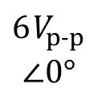

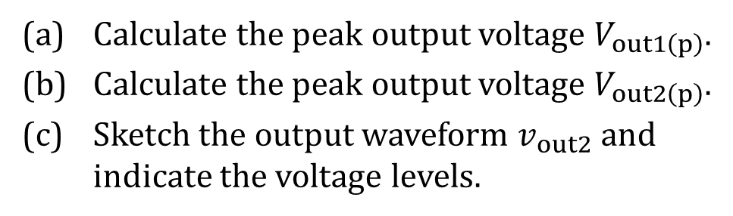



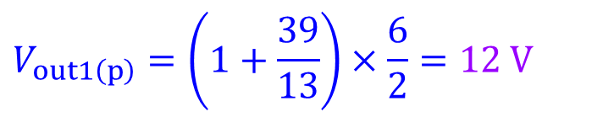


17/18 S1 B3 (modified)
Explanation
(a) Calculate the peak output voltage $V_{out1\left(p\right)}$.
(b) Calculate the peak output voltage $V_{out2\left(p\right)}$.
(c) Sketch the output waveform $v_{out2}$ and indicate the voltage levels.
39 k Ω
$$+V_{S}$$
13 k Ω
$$+V_{S}$$
−
$$v_{out2}$$
−
$$v_{out1}$$
+
+
$$−V_{S}$$
Solution
$${6 V}_{p‑p}$$
$$∠0°$$
$$−V_{S}$$
$$V_{out1\left(p\right)}=\left(1+\frac{39}{13}\right)×\frac{6}{2}=12 V$$
(a)
(b)
$$V_{out2\left(p\right)}=V_{out1\left(p\right)}=12 V$$
(c)
$$v_{out2} (V)$$
12
0
t
−12

Slide 15

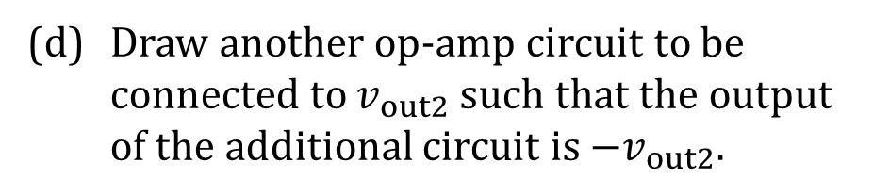

17/18 S1 B3 (modified)
(d) Draw another op-amp circuit to be connected to $v_{out2}$ such that the output of the additional circuit is $−v_{out2}.$
Solution
39 k Ω
(d)
R
$$+V_{S}$$
13 k Ω
$$+V_{S}$$
−
$$v_{out2}$$
$$v_{out2}$$
R
$$+V_{S}$$
−
$$v_{out1}$$
−
$${−v}_{out2}$$
+
+
$$−V_{S}$$
+
$${6 V}_{p‑p}$$
$$∠0°$$
$$−V_{S}$$
$$−V_{S}$$

Slide 16
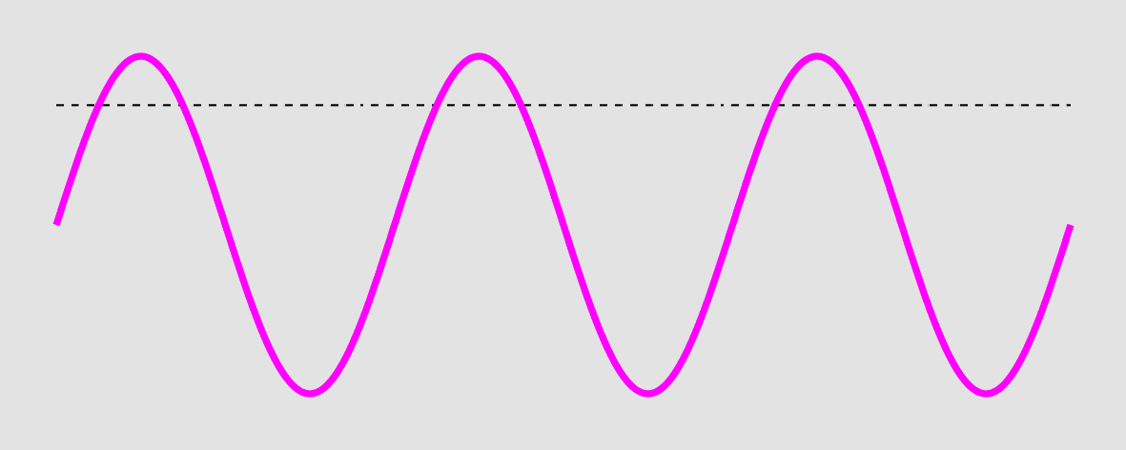




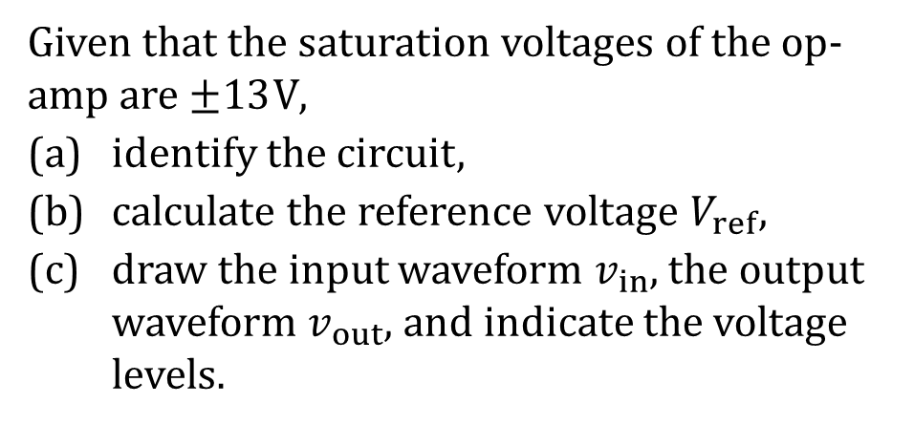



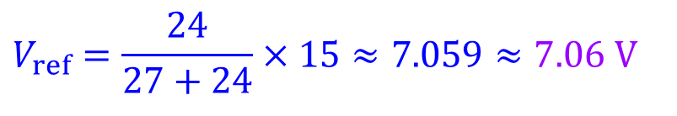


17/18 S1 B4 (modified)
Explanation
Given that the saturation voltages of the op-amp are $±13 V$,
identify the circuit,
calculate the reference voltage $V_{ref},$
draw the input waveform $v_{in}$, the output waveform $v_{out}$, and indicate the voltage levels.
Solution
(a)
Comparator circuit.
$$V_{ref}=\frac{24}{27+24}×15≈7.059≈7.06 V$$
(b)
(c)
volt
$$v_{out}$$
$$+15 V$$
13
$$v_{in}$$
10
7.1
27 k Ω
0
$$V_{ref}$$
t
−
$$v_{out}$$
$$v_{in}$$
+
−10
$$R_{L}$$
−13
$$10{ V}_{p}$$
24 k Ω
$$−15 V$$

